Slide 1
Java Plays – REST Data Services Application
IBM
Notes:
<number>

Slide 2



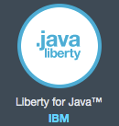

High level interaction diagram
Client (human or application)
Bluemix Java Application
Bluemix Data Services
REST
Service API
Service API
Notes:
<number>
<number>

Slide 3
Application architecture (Cloudant example control and data flow)
CloudantController
Accepts REST calls and delegates them to Cloudant Service methods.
Bluemix Data Services
REST call
Bluemix service API call
CloudantService
Accepts Java method calls and converts them to underlying Bluemix database API calls.
ServiceDiscovery
Parses VCAP_SERVICES variable and provides connection to underlying Bluemix services.
Environment variables
VCAP_SERVICES
Notes:
<number>
<number>

Slide 4
Agenda
Create Bluemix Data Services application Eclipse Java project.
Create Bluemix Data Services application with Java starter.
Import starter code to eclipse project.
Install Bluemix tools for eclipse.
Connect project to Bluemix application.
Push project to Bluemix.
Connect application to services.
Parse VCAP_SERVICES environment variable.
Create application REST service interface.
Create application data services module.
Test working application.

Slide 5
Use Case
Send REST Request
Notes:
<number>

Slide 6
Pull the code
Pull the application eclipse project from github repository.
https://github.com/ibmecod/javaplay-rest-dataservices
Notes:
<number>

Slide 7
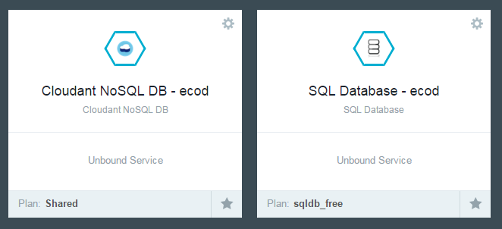
Create Bluemix Services
Example for creating Cloudant
Go to Bluemix catalog.
Double click “Cloudant NoSQL DB”.
Fill out form.
Click “OK”.
SQL Database
Cloudant NoSQL DB
Notes:
<number>

Slide 8
Application structure
REST controllers classes:
Define REST endpoints for Cloudant NoSQL DB related methods.
CloudantController
SqldbController
Business services classes:
Translate REST calls to underlying Cloudant NoSQL DB API calls.
CloudantService
SqldbService
Connection pool and utility class:
Parses VCAP_SERVICES environment variable, creates API connections.
ServiceDiscovery
Notes:
<number>

Slide 9
ServiceDiscovery class
JSONObject vcapServices;
private ServiceDiscovery()
{
// parse VCAP_SERVICES
try
{
vcapServices = new JSONObject(System.getenv("VCAP_SERVICES"));
}
catch (JSONException e)
{
throw new RuntimeException(e);
}
}
public CloudantClient getCoudantClient()
{
String host;
String username;
String password;
// parse VCAP_SERVICES
try
{
JSONObject service = vcapServices.getJSONArray("cloudantNoSQLDB").getJSONObject(0);
JSONObject credentials = service.getJSONObject("credentials");
host = credentials.getString("host");
username = credentials.getString("username");
password = credentials.getString("password");
}
catch (JSONException e)
{
throw new RuntimeException(e);
}
String account = "https://" + host;
CloudantClient cloudantClient = new CloudantClient(account, username, password);
return cloudantClient;
}
Parses VCAP_SERVICES variable.
Extract service connection parameters.
Creates connection object and returns it to business service methods.
Notes:
<number>

Slide 10
Business Service: CloudantService
Get Cloudant client object
Retrieves Cloudant client object from ServiceDiscovery class.
Example of API method “getDatabase”:
Uses Cloudant client object to call underlying Cloudant API.
private final CloudantClient cloudantClient;
public CloudantService()
{
cloudantClient = ServiceDiscovery.getInstance().getCoudantClient();
}
API method: getDatabase
public List<String> getDatabases
(
)
{
return cloudantClient.getAllDbs();
}
Notes:
<number>

Slide 11
public List<Map<String, Object>> select
(
Integer id
)
{
List<Map<String, Object>> output;
try
{
if (id == null)
{
output =
queryRunner.query
(
"select * from \"MYTABLE\"",
new MapListHandler()
);
}
else
{
output =
queryRunner.query
(
"select * from \"MYTABLE\" where \"ID\" = ?",
new MapListHandler(),
new Object[]{id, }
);
}
}
catch (SQLException e)
{
throw new RuntimeException(e);
}
return output;
}
Business Service: SqldbService
SQL data source and query runner
private final QueryRunner queryRunner;
public SqldbService()
{
queryRunner =
new QueryRunner
(
ServiceDiscovery.getInstance().getSqldbDataSource()
);
}
Retrieves SQL data source from ServiceDiscovery class.
Initializes query runner client with this data source.
Example of API method “select” (on the right):
Uses initialized query runner object to query data from SQL database.
Notes:
<number>

Slide 12
REST Controller: CloudantController
CloudantService reference
Inject CloudantService object for all REST endpoints to use.
Each end point redirects call to corresponding CloudantService method.
private final CloudantService cloudantService;
public CloudantController()
{
cloudantService = new CloudantService();
}
REST end point example
@GET
@Path("/getDatabases")
@Produces(MediaType.APPLICATION_JSON)
public List<String> getDatabases
(
)
{
return cloudantService.getDatabases();
}
Notes:
<number>

Slide 13
REST Controller: SqldbController
SqldbService reference
Inject SqldbService object for all REST endpoints to use.
Each end point redirects call to corresponding SqldbService method.
private final SqldbService sqldbService;
public SqldbController()
{
sqldbService = new SqldbService();
}
REST end point example
@GET
@Path("/select")
@Produces("application/json")
public List<Map<String, Object>> select
(
@QueryParam(value = "id") Integer id
)
{
return sqldbService.select(id);
}
Notes:
<number>

Slide 14
Test application – install Chrome REST client
Download and install Chrome REST client:
https://chrome.google.com/webstore/detail/advanced-rest-client/hgmloofddffdnphfgcellkdfbfbjeloo?hl=en-US
Notes:
<number>

Slide 15
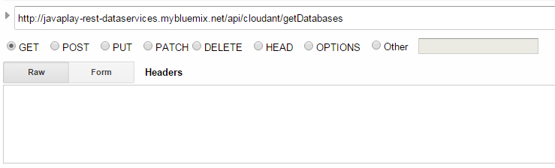
Test application – test Cloudant getDatabases
In Chrome REST client enter these parameters:
You should receive a JSON array with database names.
Notes:
<number>

Slide 16
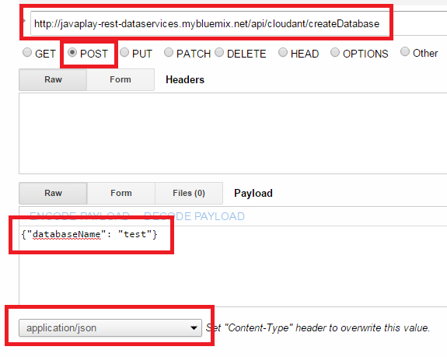
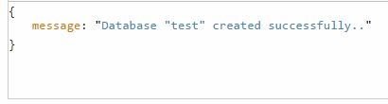
Test application – test Cloudant createDatabase
In Chrome REST client enter these parameters:
You should receive similar response.
Notes:
<number>

Slide 17
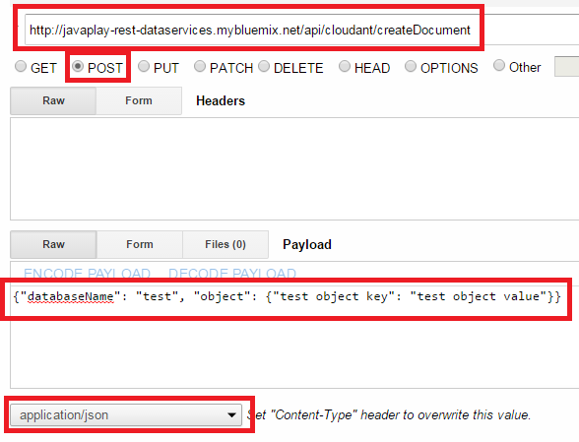
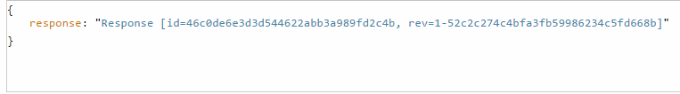
Test application – test Cloudant createDocument
In Chrome REST client enter these parameters:
You should receive similar response.
Notes:
<number>

Slide 18
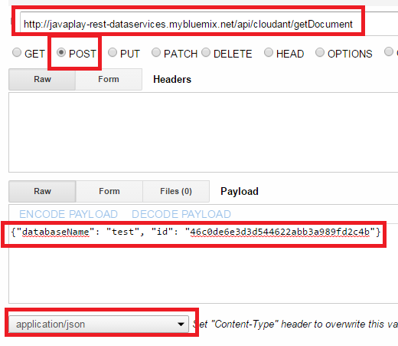
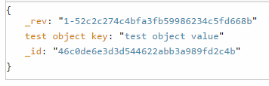
Test application – test Cloudant getDocument
In Chrome REST client enter these parameters:
You should receive similar response.
Notes:
<number>

Slide 19
Extend the code to utilize other services
Add service Java client library into /WebContent/WEB-INF/lib project folder.
Create new service on Bluemix.
Add service to application environment variable.
Add service name into manifest.yml if deploying with CF push command.
Mark service as used by application if deploying with eclipse Bluemix tools.
Add method to ServiceDiscovery class to parse VCAP_SERVICES variable and return either client object instance for non-JDBC services or data source for JDBC services.
Create service class similar to CloudantService class.
Service class should obtain client object or data source from ServiceDiscovery class at initialization.
Create any number of service methods those call corresponding underlying service API.
Create controller class similar to CloudantController class.
Annotate class with @Path annotation.
Create any number of REST methods and annotate them with @GET/@POST, @Path, @Consumes, @Produces annotations.
REST methods should delegate to corresponding service class methods.
Notes:
<number>

Slide 20
Instructions on how to build new REST project using this project as a base
Open javaplay-rest-dataservices project in eclipse.
Create Cloudant service on Bluemix.
Create application on Bluemix. Bind Cloudant service to application.
Download application code archive.
Import application code archive as new project in eclipse.
Copy and paste classes from javaplay-rest-dataservices project to new project.
Modify new project code as needed. Example changes:
Change REST methods URL.
Deploy application to Bluemix.
Notes:
<number>

Slide 21
Questions?

